Slide 1

Java and Spring Security

Slide 2
Java EE Security API :
Java EE applications usually consist of multiple components. A container holds these components. Java EE’s security model specifies that the container must provide or support certain security features. You can implement these features in two ways: declarative and programmatic.
Declarative: the developer specifies security requirements in the deployment descriptor and / or in code using annotations. The cool thing about annotations is that you can place them on your classes and / or methods instead of writing lengthy XML code.
Programmatic: offers the ability to make security related decisions based on the security context. “The Java EE Tutorial, Release 7” documentation recommends this approach .
Java security API span a wide range of areas like ( cryptography, public key infrastructure, secure communication, authentication, and access control )
Notes : Both approaches are based on the Java Authentication and Authorization Service (JAAS) API.

Slide 3
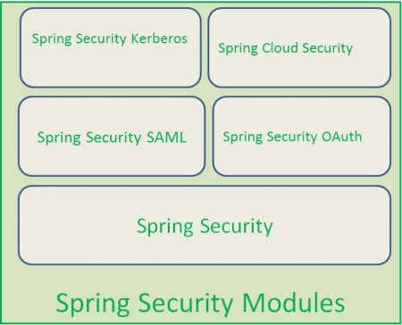
Spring Security
Spring Security SAML (Security
Assertion Markup Language like SSO )
Spring Security OAuth
Spring Security Kerberos
Spring Cloud Security
Spring Security supports the following two Levels of Authorization
Method Level Authorization
URL Level Authorization
Method Level Security” by using AOP (Aspect-Oriented Programming) that means through Aspects.
Spring Security supports “URL Level Security” by using Servlet filters.

Slide 4
Spring 3.x and 4 Security Framework provides the following Features:
Authentication and Authorization.
Supports BASIC,Digest and Form-Based Authentication.
Supports LDAP Authentication.
Supports OpenID Authentication.
Supports SSO (Single Sign-On) Implementation.
Supports Cross-Site Request Forgery (CSRF) Implementation.
Supports “Remember-Me” Feature through HTTP Cookies.
Supports Implementation of ACLs (Access Control List (ACL) is a list of permissions attached to an object)
Supports “Channel Security” that means automatically switching between HTTP and HTTPS.
Supports I18N (Internationalisation).
Supports JAAS (Java Authentication and Authorization Service).
Supports Flow Authorization using Spring WebFlow Framework.
Supports WS-Security using Spring Web Services.
Supports Both XML Configuration and Annotations. Very Less or minimal XML Configuration.
Spring 4.x Security Framework supports the following New Features:
Supports Web Socket Security.
Supports Spring Data Integration.
CSRF Token Argument Resolver.

Slide 5
Security Sub-Modules :
Spring Security Core Module
Spring Security Configuration Module
Spring Security Web Module
Spring Security Tag Library Module
Spring Security AspectJ Module
Spring Security ACL Module
Spring Security LDAP Module
Spring Security OpenID Module
Spring Security CAS Module (Central Authentication Service ex SSO )
Spring Security Cryptography Module
Spring Security Remoting Module
https://docs.spring.io/spring-security/site/docs/current/reference/html/modules.html

Slide 6
Client
Server
xml
Client
Server
OTP /Alphabets
Client
Server
OTP two way communication Mobile / Any mail
Client
Authorization Server
Server

Slide 7
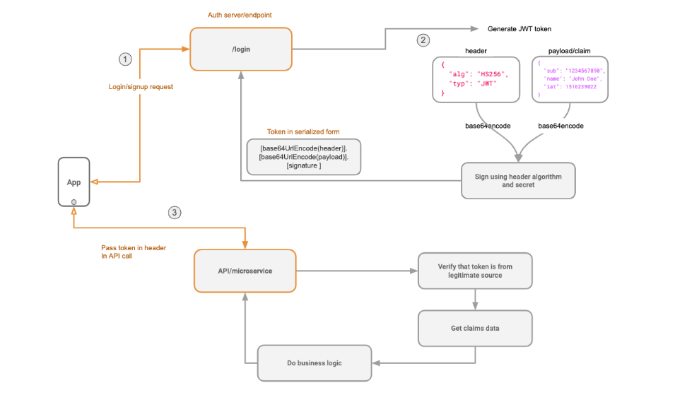

Slide 8
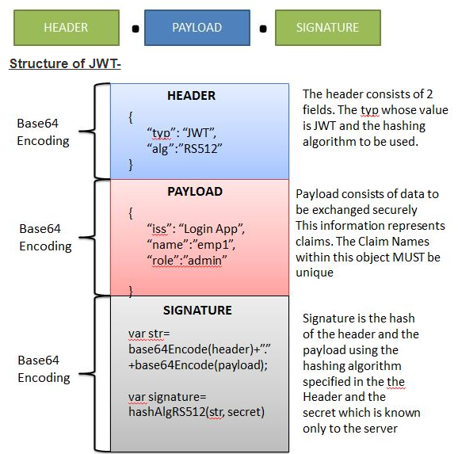

Slide 9
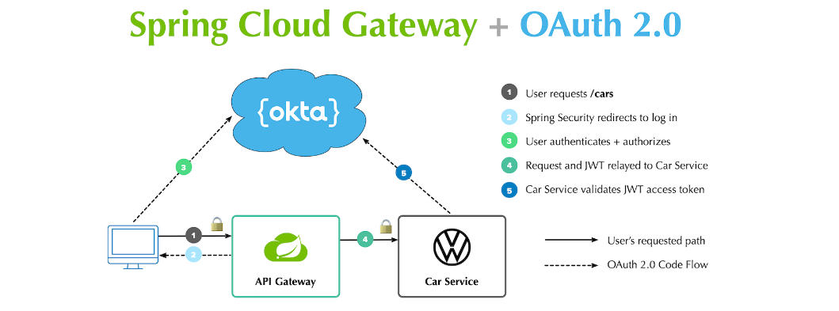

Slide 10
Thank you All

